Slide 1
How to use this presentation
Before showing or sending this presentation to staff, you need to fill in a few details about your company and add your company logo.
Anywhere with PURPLE you need to amend / customize before using….

Slide 2
Welcome to the Care Friends App

Slide 3
What is Care Friends?
We suggest you play the app introductory video at this point.
You can download it and embed it in this slide, or you can show it using the link: https://vimeo.com/345969567

Slide 4
Please take out your phones…..

Slide 5
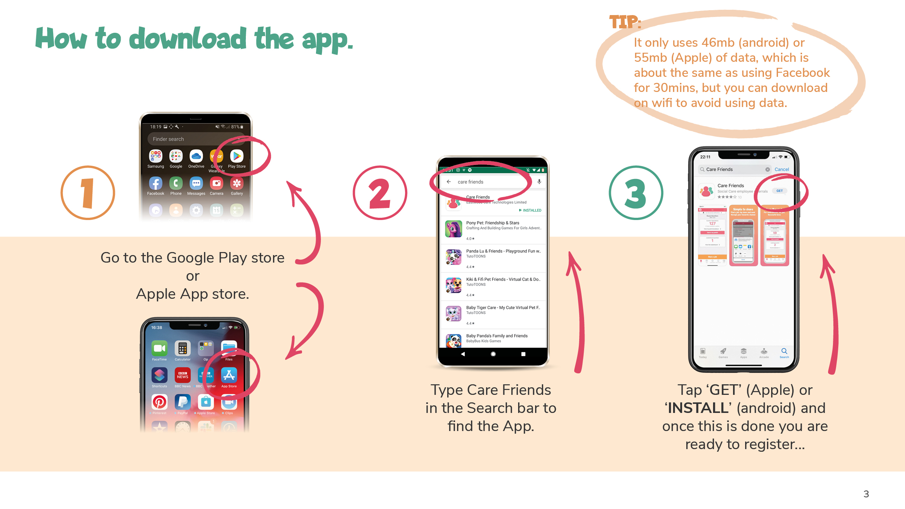

Slide 6
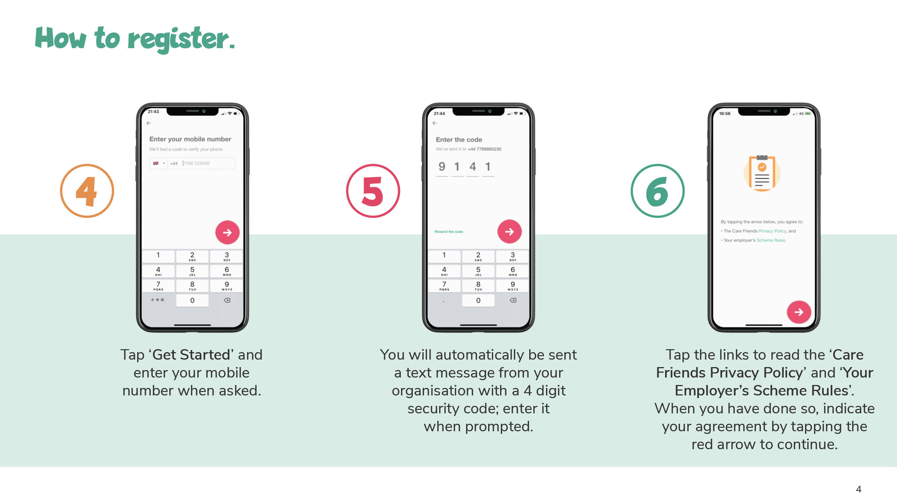

Slide 7
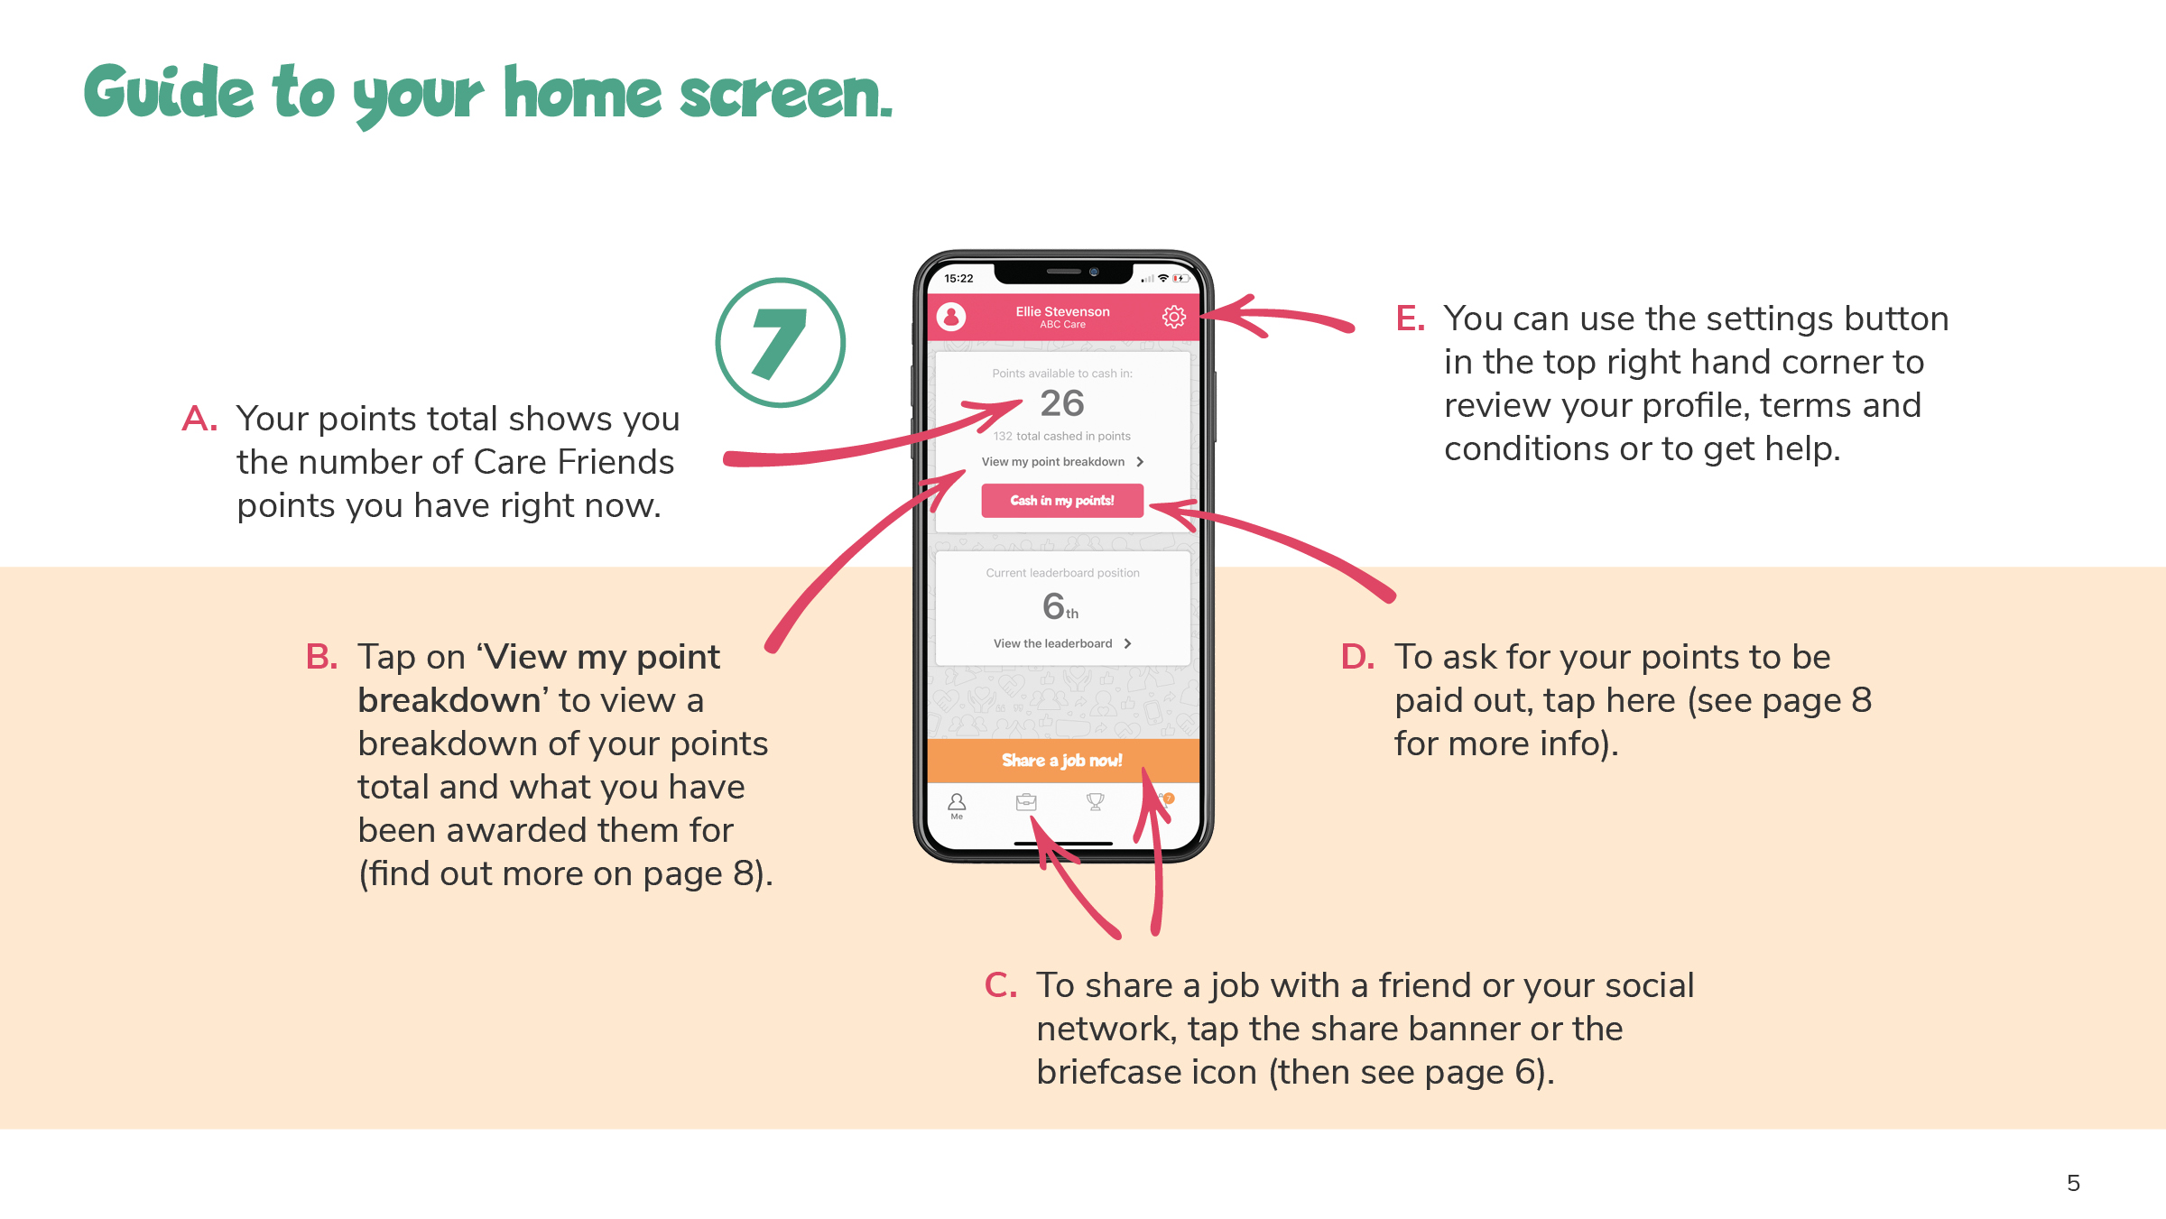

Slide 8
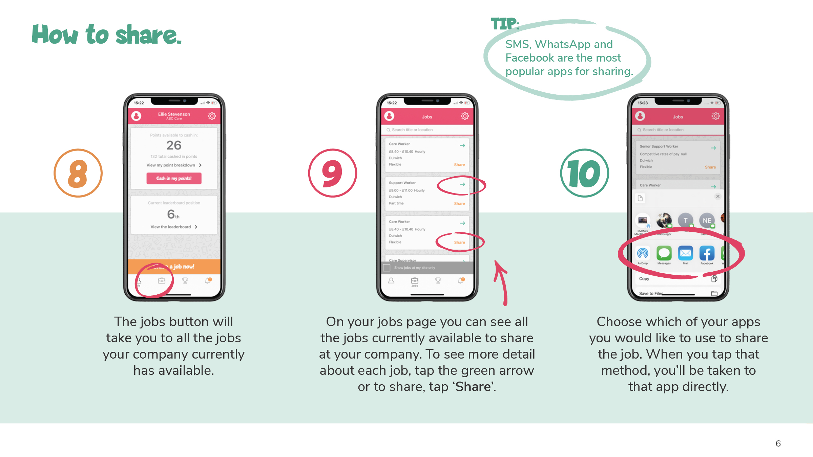

Slide 9
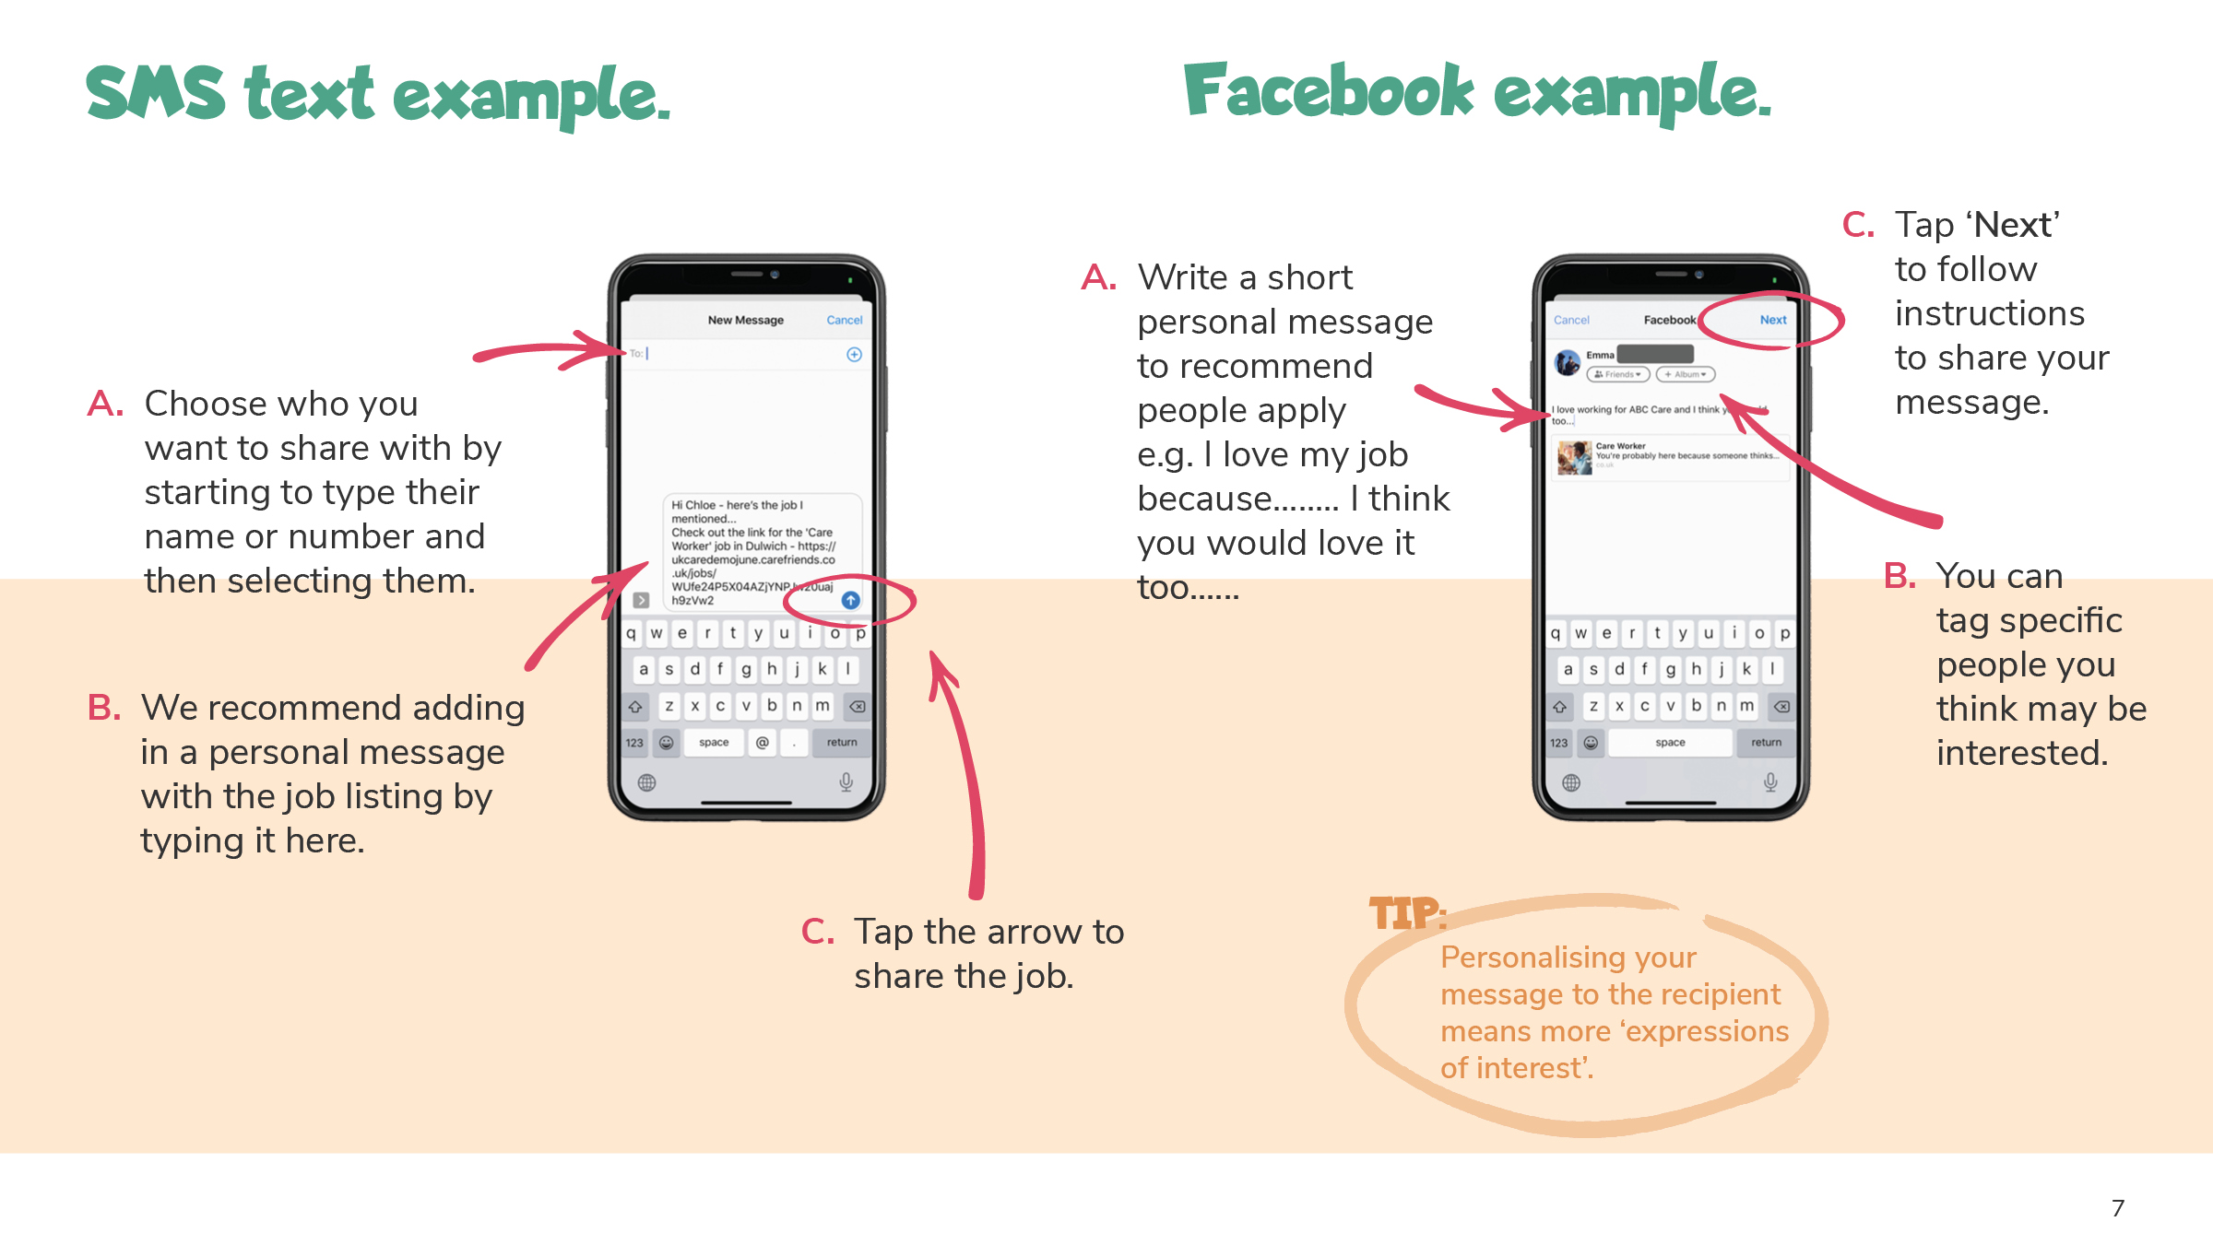

Slide 10
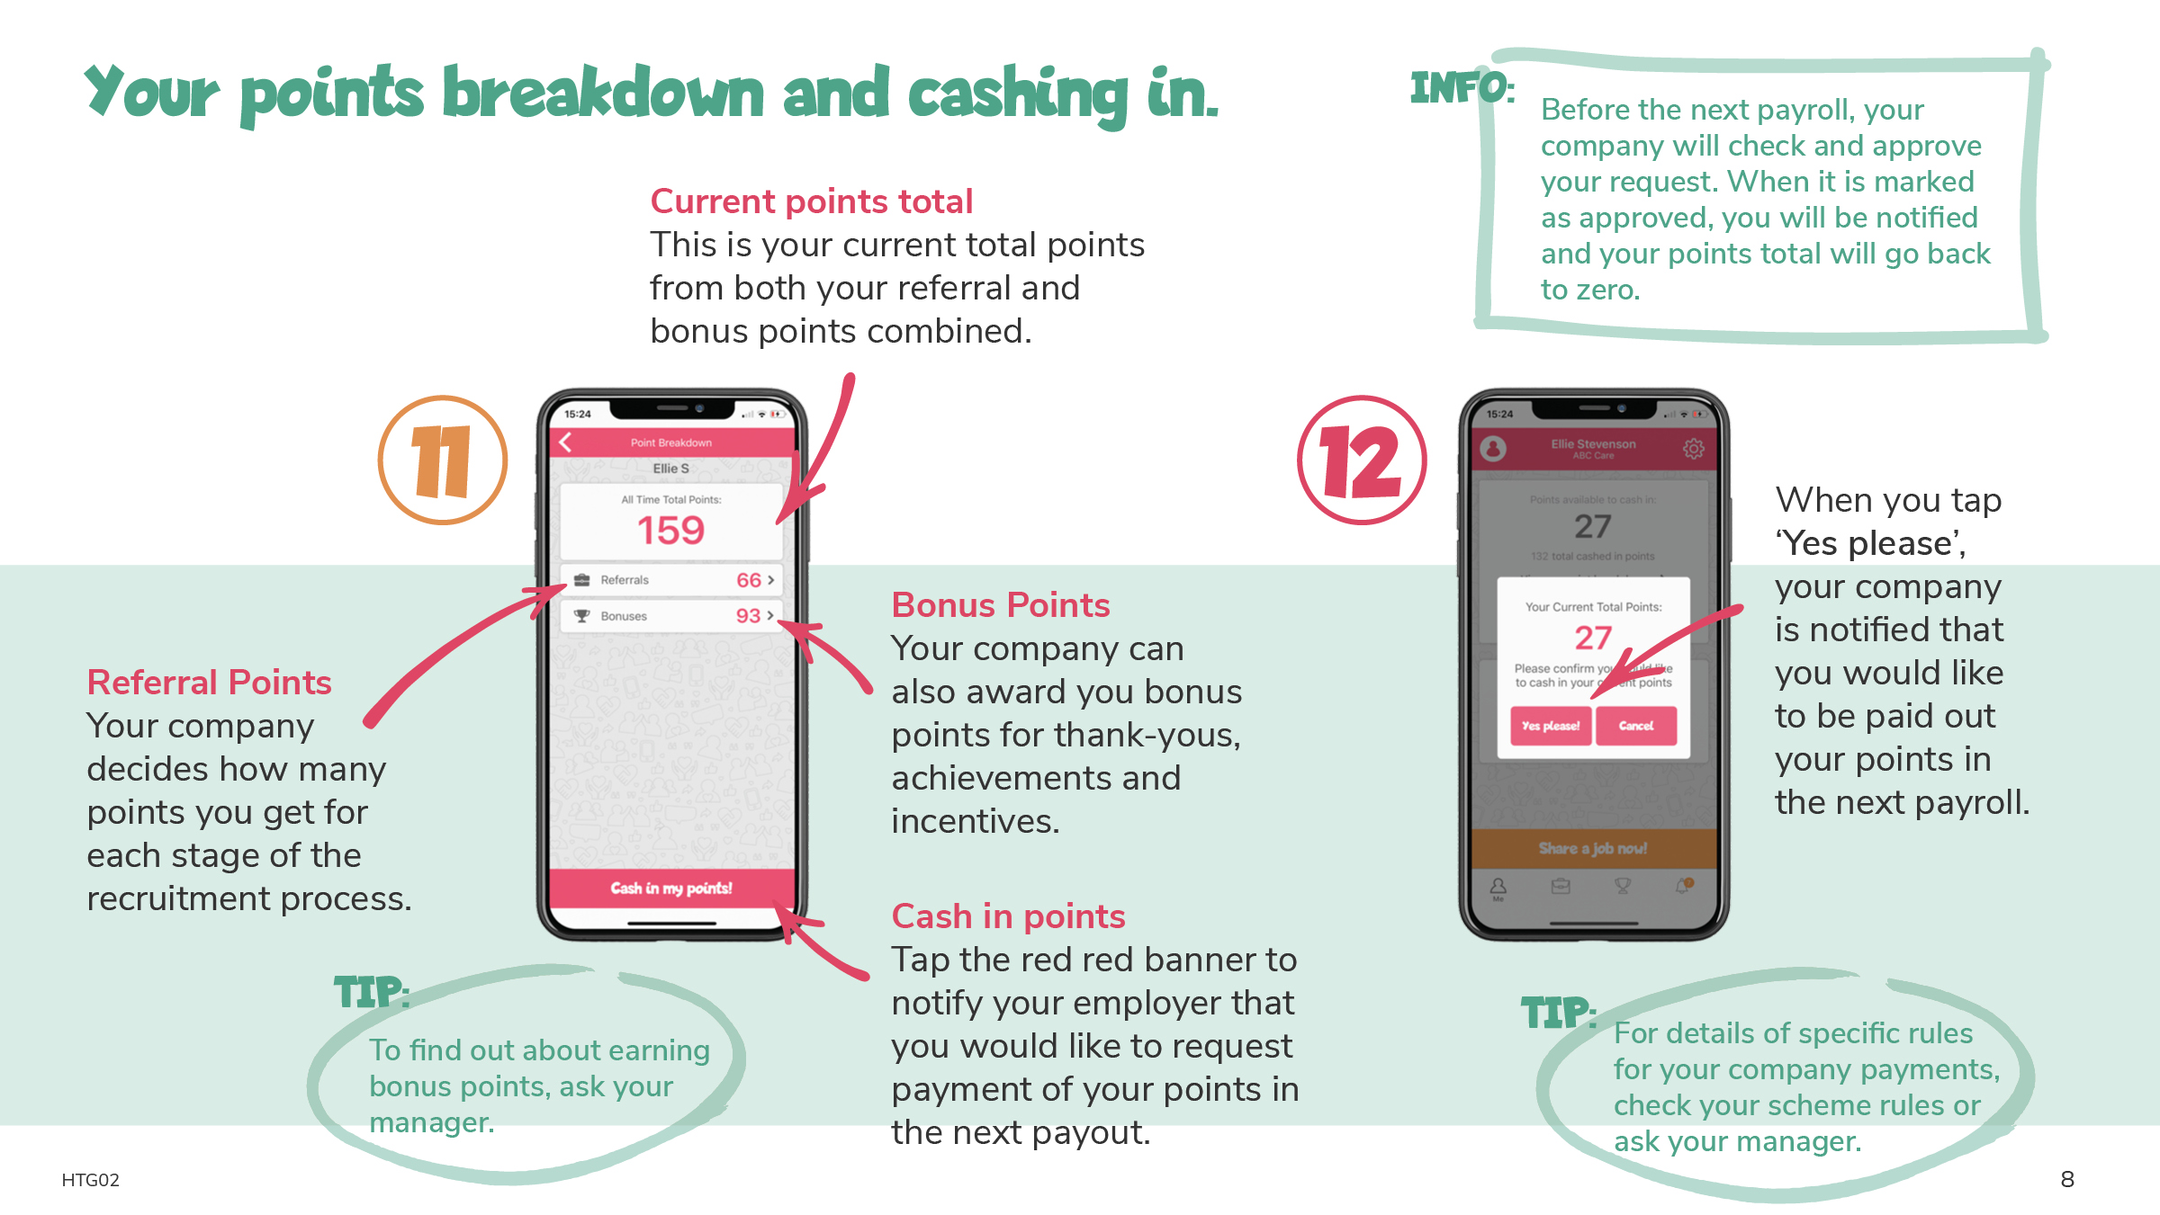

Slide 11
Our Scheme Rules

Slide 12
Referral Points Allocations
Trigger | Point Allocation | Notes
Sharing a job in good faith | 1 | *Up to max 10 points per month
Expression of interest submitted | 3
Successful interview | 10 | *unsuccessful interviews and no shows are not eligible for points
Completion of first day’s work | 75 | *or part thereof
Candidate is New to Care | 15 | *allocated when candidate starts only
Candidate stays 12 months | 30

Slide 13
Eligibility
All ABC Care full time / part time / bank staff are eligible to download the app and use it to earn referral points except: [Senior Managers] [Recruiters]
Referral points will only be awarded for candidates who meet the following criteria: [insert to “Who can be referred?” section from scheme rules here]
Shares must be made IN GOOD FAITH i.e. you must believe that the person or people you are sharing with could be interested in a position at ABC Care. If we believe that you are sharing jobs not in good faith, we reserve the right to a) revoke any referral points from sharing or previous candidates b) disqualify you from sharing jobs and/or earning referral points in the future.

Slide 14
Bonus Points
Please include an overview of any decisions / guidance / rules your organization has for the allocation of bonus points. This could include e.g. some set point allocations for certain actions and/or simply that they will be given entirely at managers discretion….
Trigger | Bonus Point Allocation
100% attendance in a month | 10
Positive feedback from service user | 15
Employee of the month | 25
Attendance at staff training / meeting | 5

Slide 15
Payment Rules
Points will be ‘paid out’ in the normal payroll – they are therefore subject to tax and normal deductions
To be paid out in that month’s payroll, requests must be submitted via the app by the 15th of the month
You must have a minimum of 10 points before you request to cash in your points

Slide 16
Questions? If you have any questions about using the Care Friends App, please contact please enter your name and contact details here or email support@carefriends.co.uk

Slide 17
‘Caring people know caring people’

