Slide 1
Care Friends for managers
Caring people know caring people

Slide 2
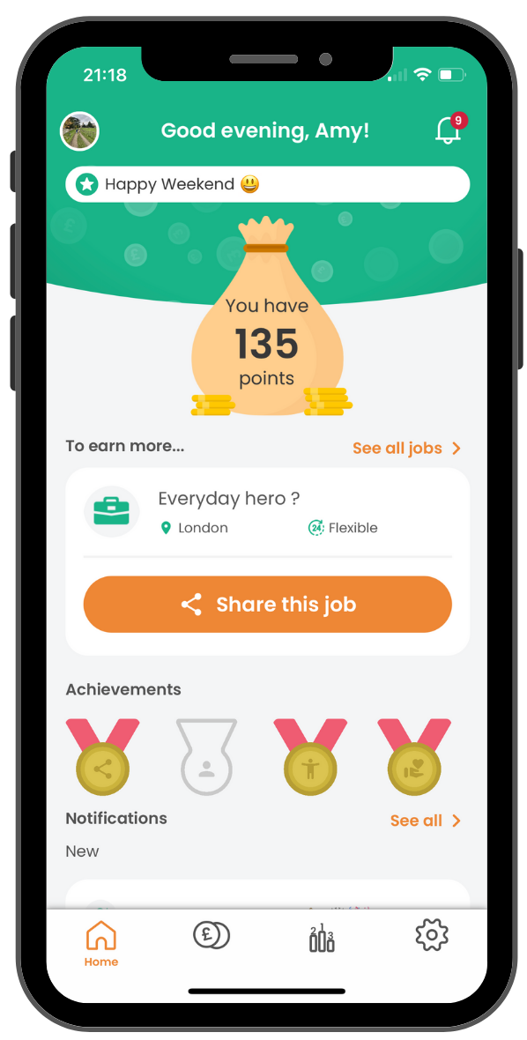
Why use an app for employee referrals?
Maximises the number of referrals you get
Makes it fun and engaging for staff
Makes admin simple
Avoids overlooked payments and hassle
Allows you to pay bonus points as a thank you or well done

Slide 3
How the app works: an overview

Slide 4
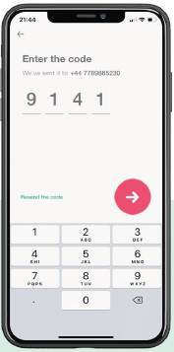
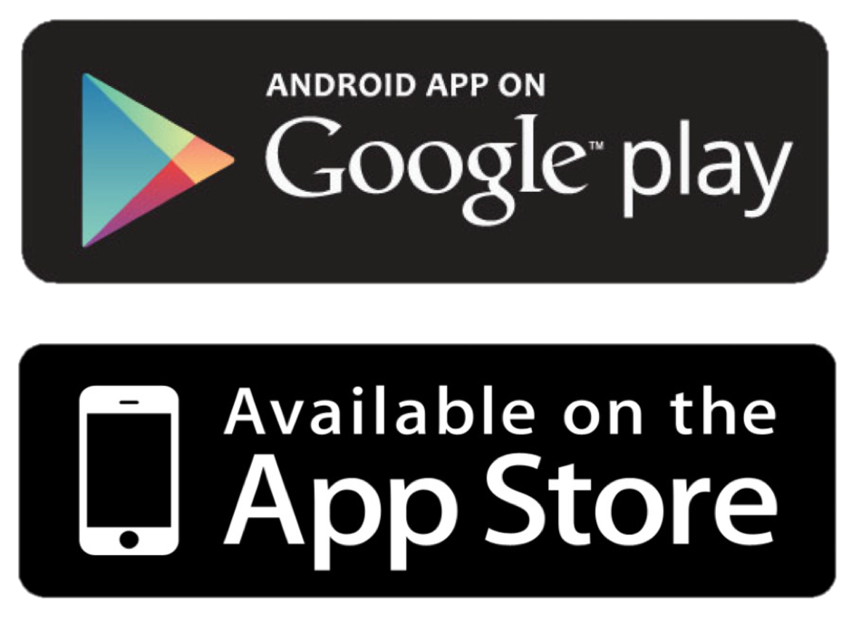
What do staff have to do to download the app?
1. Go to the App Store or Google Play and download the app to a personal phone
2. Enter their mobile number
3. Enter the security code which they will automatically receive by text

Slide 5
What makes a successful launch?
Success factors:
Local ‘champions’
Manager uses the app
Launch incentive
Celebrate success!
Find resources to support you with all of the above here
Target: 80% of staff downloading the app within 2 weeks of launch

